Slide 1
SimPlan
Clyde, Dawei, Jjingjie, KT

Slide 2
What is SimPlan?
SimPlan is an application that is designed with the college student in mind.
We at Team Six sought to provide solutions to class registration, daily schedule management, and notification management for both students and professors.

Slide 3
The Tools We Offer
First, SimPlan provides a calendar where users can view all scheduled appointments and lectures. Users can also schedule personal events into their calendar.
Second, SimPlan offers a class registration system, which will add a class to your schedule after filling out a short series of text fields.

Slide 4
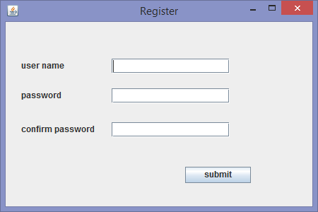
Registration
New SimPlan users will start by creating their own account. Users will register for their account by choosing a username and password.

Slide 5
Development Tools and Resources
JDK 1.8 is our platform of choice for this application.
We used MyEclipse 2014 as our IDE.

Slide 6
A SimPlan Tour
Let’s start by demonstrating the main features of SimPlan.

Slide 7
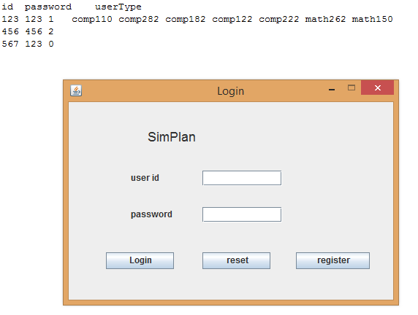
Login Page uses the txt file “idAndPassword.txt” as a database for accounts.

Slide 8
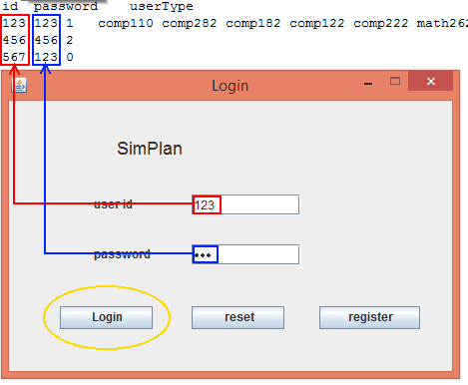
Upon clicking login button after writing your user id and password, the software will loop to see the account you have inputted matches any of the account in the database.
If the user id and password lines have nothing on them, clicking login will result in simple error and software will not access its database.

Slide 9
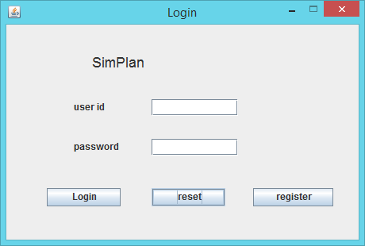
Reset button will empty both user id and password field for convenient use.

Slide 10
Clicking the register button will open register menu.
Register option will allow users to add new accounts.

Slide 11
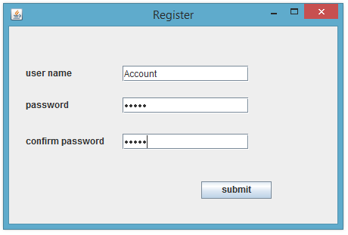
Once all fields are completed properly, a new account will be created and stored to the database, which can now be checked by the login option.

Slide 12


The idAndPassword.txt will update itself every time new account is added through register.

Slide 13
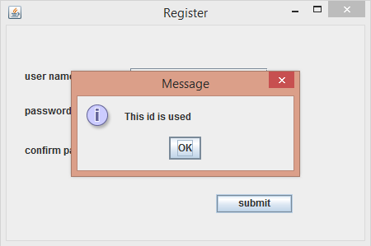
Software will return an error if you attempt to register with an account id that is already being used.

Slide 14
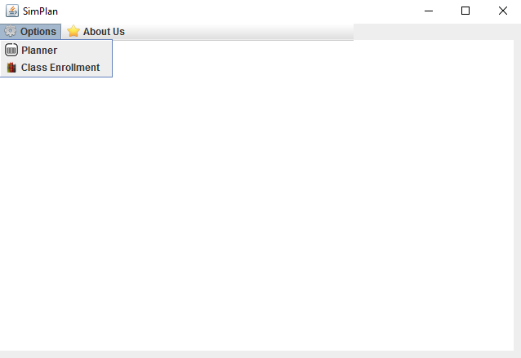
The Calendar
To access the calendar, we will go to Options and select it from the drop-down menu.

Slide 15
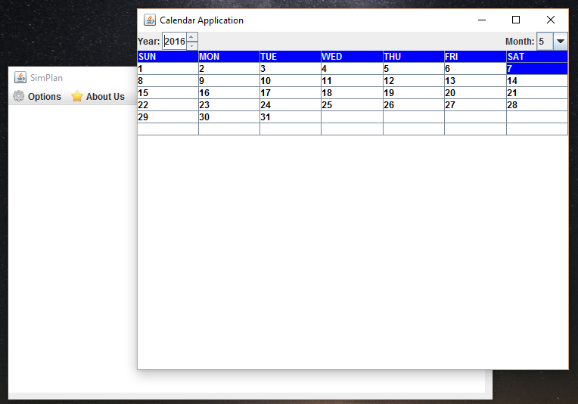
The Calendar
Here we have the calendar view. The user can then select a day to view events or add events. The selected day will be highlighted in blue.

Slide 16
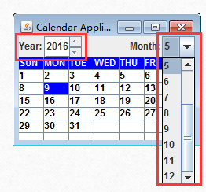
The Calendar
The User can select any year or month by using the year spinner and the month combo box.

Slide 17
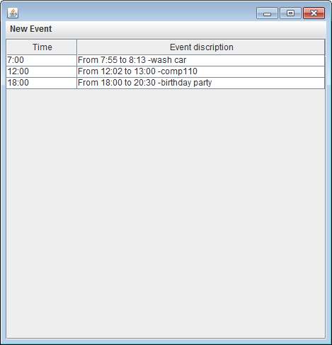
View Events
Double clicking the date on the Calendar will pop out a window that shows all existing events for that day

Slide 18
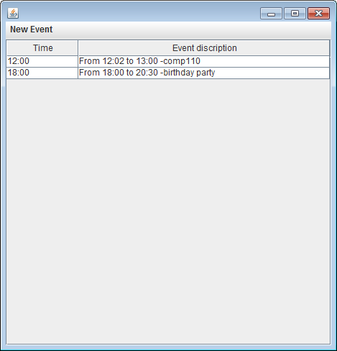
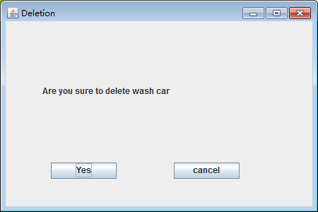
Delete Event
Double clicking the description of the existing event will pop a confirmation window to delete the event.

Slide 19
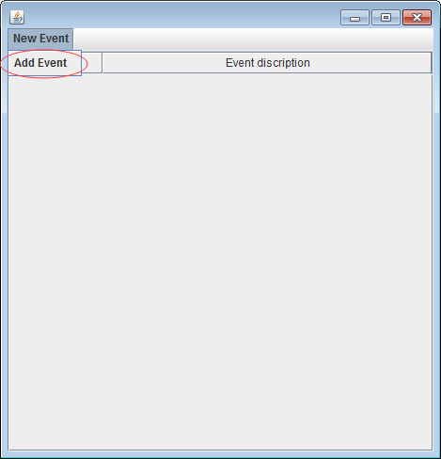
New Event
After clicking on a date, the user can add a new event by selecting the “New Event” option in the upper-left hand corner.

Slide 20
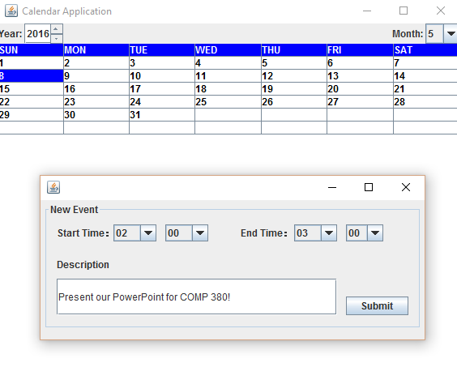
New Event
Once the option has been selected, the user will fill in the details for this event.
We have safeguarded this feature to ensure that the ending time cannot be earlier than the starting time.

Slide 21
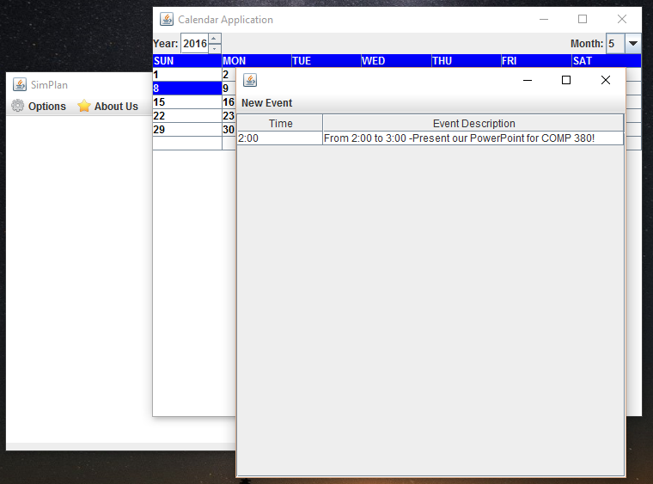
New Event
The event has been successfully added to the database and now shows in the user’s event page.

Slide 22
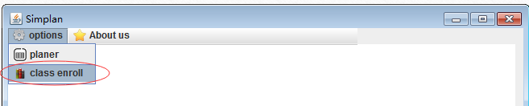
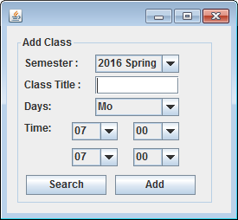
Class Enrollment
To enroll in a class, click the class enroll button on the main frame. The class enrollment page will pop up.

Slide 23
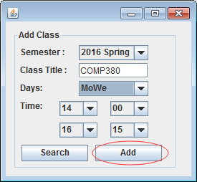
Class enrollment
For example, here we are adding COMP 380.

Slide 24
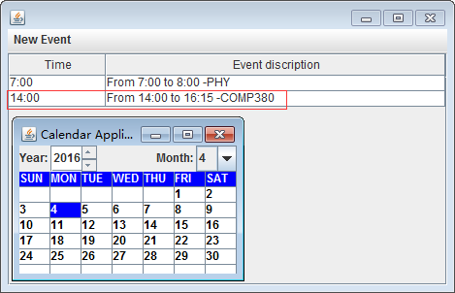
Class enrollment
The class will display on every Monday and Wednesday in the Spring semester.

Slide 25
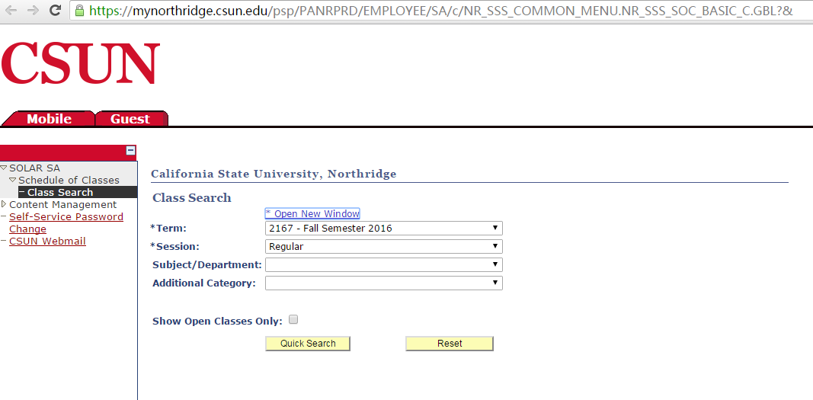
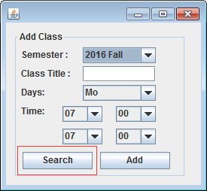
Class enrollment
The search button will open the link of class searching page.

Slide 26
Lessons Learned
The design of the software is important.It’s hard to add some attributes after you start coding.We can implement less but we need to design much.
Communication between team member make work more efficient.
Do the unit test before you add methods to the class.So it will be easy to debug.

Slide 27
Questions?

